Slide 1
Physics-informed U-shaped Neural Operators
Avi | Shaurjya | Rochan
24-787 Final Project Presentation
December 8th, 2022
Notes:
Main title: 40 pt. Arial
Presenter Name: 16 pt. Arial
Presenters Title: 16 pt. Arial Italic

Slide 2
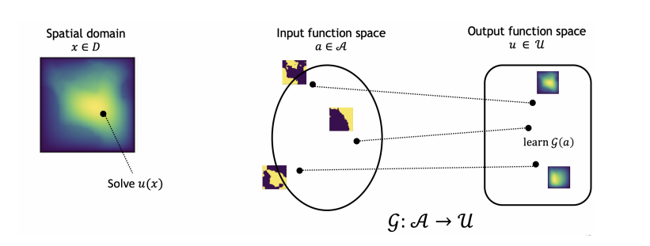
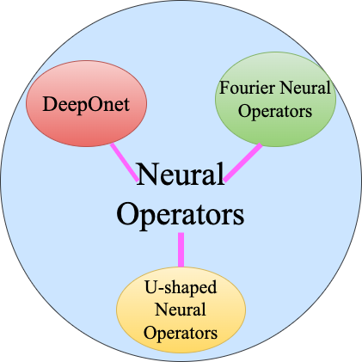
Background
What if you wanted to optimise a neural operator solution to a single instance ?
Train PINN’s for each instance
Computationally expensive
Do not achieve the most optimized results
Retrain Operator with Physics–Informed loss on the instance
Computationally cheap
Has shown to show better results
Notes:
PINN’s :- Can only train on single instance of the PDE. Difficult to converge on challenging PDE constraints.
NO :- Learn only from data. When data is low, do not perform really well.
Requirement :- Adding Physics based information to the neural operator.

Slide 3
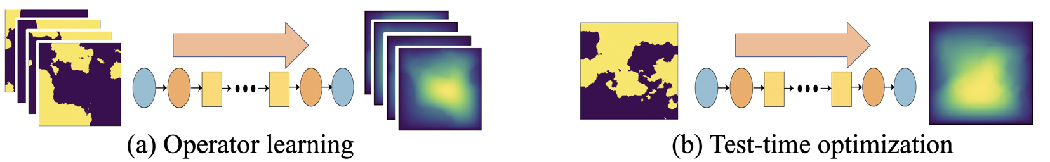
Model Overview
Neural Operator
Use the PINN training method on the single instance
Notes:
Advantages PUNO vs PINN test time optimization is the online training process as the Operator can be trained Offline hence giving PUNO significant advantage in speed.

Slide 4
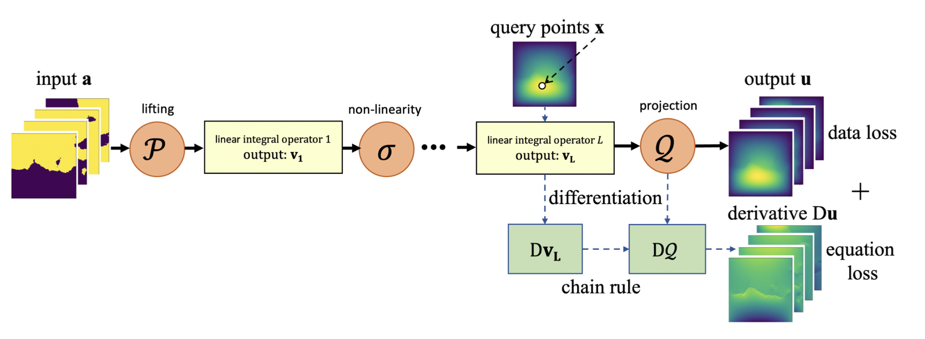
Model Overview
Notes:
Advantages PUNO vs PINN test time optimization is the online training process as the Operator can be trained Offline hence giving PUNO significant advantage in speed.

Slide 5
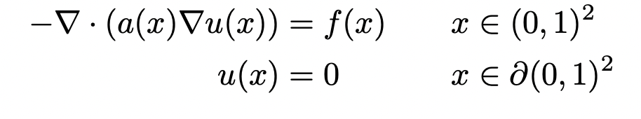
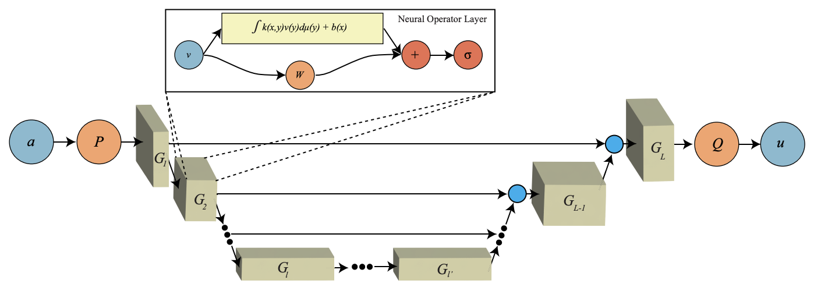
Darcy Flow and U-shaped Architecture
Notes:
Darcy's law is an equation that describes the flow of a fluid through a porous medium.In our f(x) is taken to be 1 throughout as it is the case with most physical scenarios. After sampling a(x) from a gaussian distribution the PDE was solved on a grid of 211*211. The model that we have chosen to optimize using physics informed loss is the U-shaped Neural operator which combines the Spectral Layer from FNO and the U-Net architecture with GELU as the activation function.
The network consists of a contracting path and an expansive path, which gives it the u-shaped architecture. During the contraction, the spatial information is reduced while feature information is increased. The expansive pathway combines the feature and spatial information through a sequence of up-convolutions and concatenations with high-resolution features from the contracting path.

Slide 6
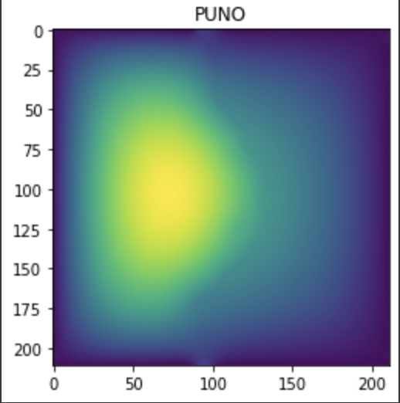
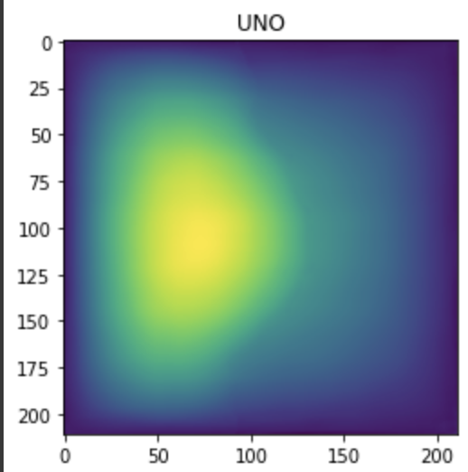
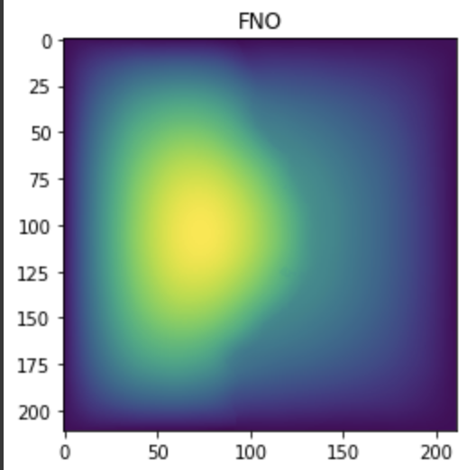
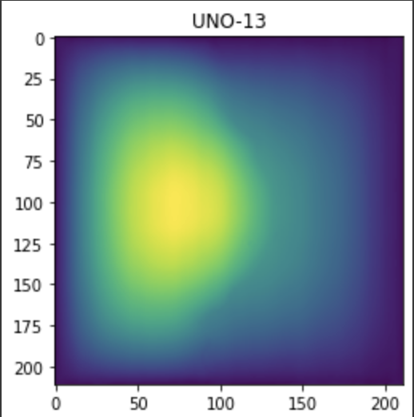
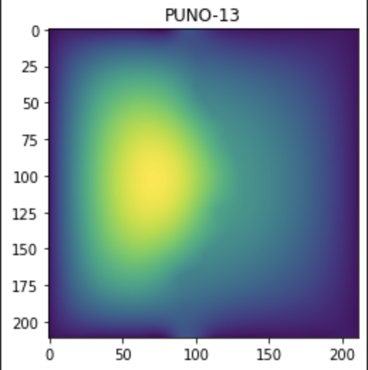
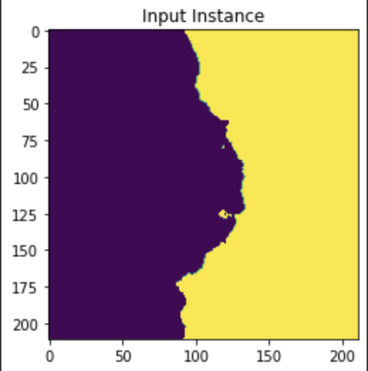
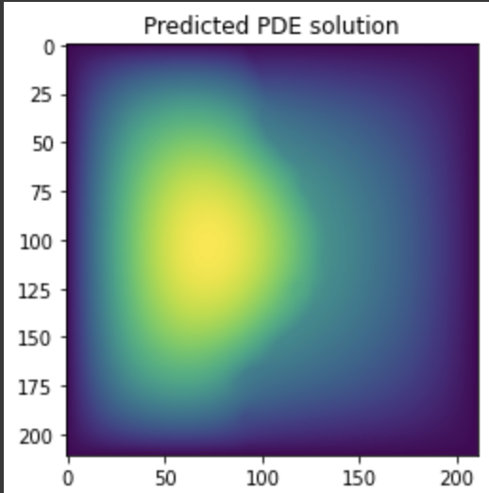
Results
Models | Error
PUNO | 2.1400698087762242e-08
UNO | 2.314775943450188e-08
FNO | 6.783312478498672e-09
UNO-13 | 2.096094856415352e-08
PUNO-13 | 1.3017107821017466e-07
Notes:
We have tried out 2 different UNO architectures with varying depths. Hence increasing the parameters. The Physics Informed UNO was able to improve upon the results of UNO. The results of Physics informed Model can be made better by increasing the amount of data being given to the model. Right now we have given double weightage to the data loss than pde loss but with low number of points. The FNO is still able to perform the best but has double the number of parameters and more training time than the UNO models.
Some Future work that Can be done to make this model better
We used the finite difference method to calculate the physics informed loss because it is difficult calculate derivative of spectral layers using autograd.
Finding the right ratio of split between the data loss and pde losses.
Implementing LBFGS instead of Adam as the optimizer.

